Slide 1
Y.E.S. Volunteering Web App
BY RAYAN WALI
PERIOD 3
MS. LORENA

Slide 2
Background and Problem Statement
The Y.E.S. volunteering hour storage process takes a long time and is not efficient in terms of organization and storage of a log of hours.

Slide 3
Proposed Solution
I decided to make this application to fix that, eliminating the tedious paper-based manual approval and the management process and making the entire process eco-friendly.

Slide 4
Functional Specifications
Allow students to register and capture student information e.g. email address, graduation year, etc.
Allow students to record and manage volunteering hours
Allow students to view and filter stored volunteering hours
Allow students view reports and graphs of completed hours
Students should only be able to view their data
Volunteering hours approval process that allows administrator to approve or reject hours

Slide 5
High-Level Y.E.S. Web App Design
Client
(Browser)
ASP.NET Core Web App
(Web Listener Host/IIS Server)
Database
HTTP Request
Email Service
Entity Framework
ASP.NET Core Identity
Entity Framework
SQL
Razor Pages
Model
Startup
HTTP Response
Filters
Layouts
CSS
Notes:
Entity Framework: an object-relational mapper (O/RM), enabling .NET developers to work with a database using .NET objects. We open a connection to the database, create a DataSet to fetch or submit the data to the database, convert data from the DataSet to .NET objects
Razor Pages: is an ASP.NET programming syntax used to create dynamic web pages with the C# or Visual Basic .NET programming languages. It uses HTML in combination with C#. It was introduced as part of MVC (Model-View-Controller)
CSS: Cascading Style Sheet
Layouts: Menu Items; Page Format for e.g. adding new menu item on the web page
Startup: Initial configuration of web application goes here. For e.g., database connection string, database context etc.
Core Identity: User login information including register of user and user credentials

Slide 6
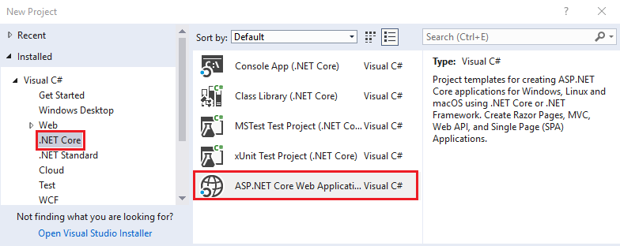
Sequence of Activities - Completed
Installed core application development components including Visual Studio 2017, SQL Server Express, and .Net Framework
Created a Razor Web application using C#:
Notes:
Razor Page: Combination of HTML and C#

Slide 7
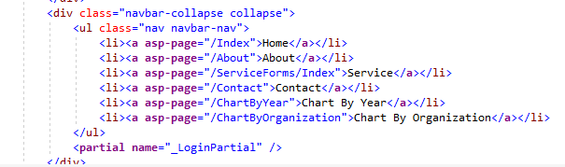
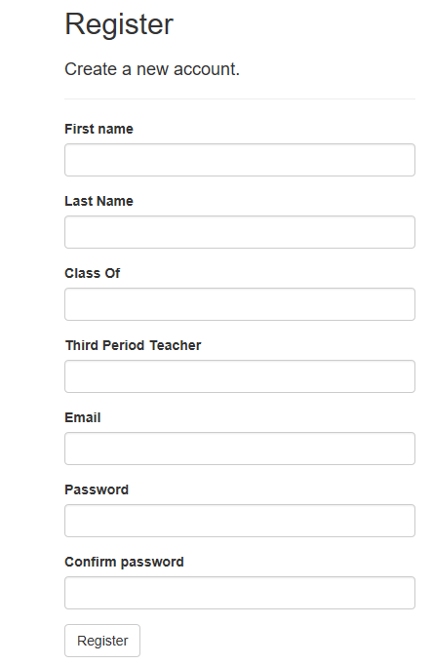
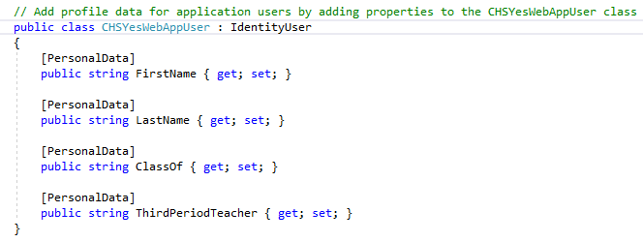
Sequence of Activities - Completed
Shared\_Layout.cshtml
Created the Menu
Extended Identity Provider and Register page to capture additional student information

Slide 8
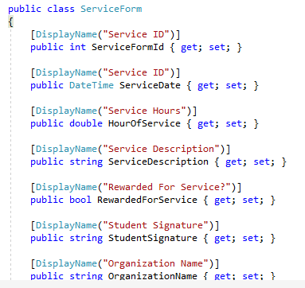
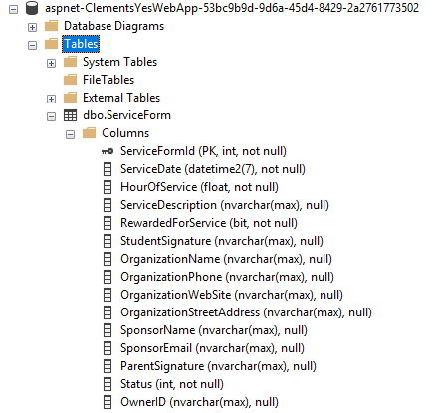
Sequence of Activities - Completed
Created model class for volunteering application form.
Created database from volunteering application form class model.
Package Manager Console
Add-Migration Initial
Update-Database

Slide 9
Work in Progress and Next Focus Items
Create, Read, Update, and Delete (CRUD) operation on volunteering form
Approval of the workflow process e.g. Accept or Reject form
Filtering data on the form e.g. filter by organization
Searching information on the form e.g. search by contact person
Implementing role base security e.g. admin can access everything
Creating reports and graphs
Finalize the Web Application with graphics and stylesheets

